Slide 1
FlexPod Update

Slide 2
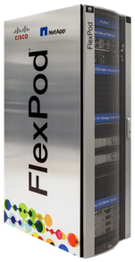
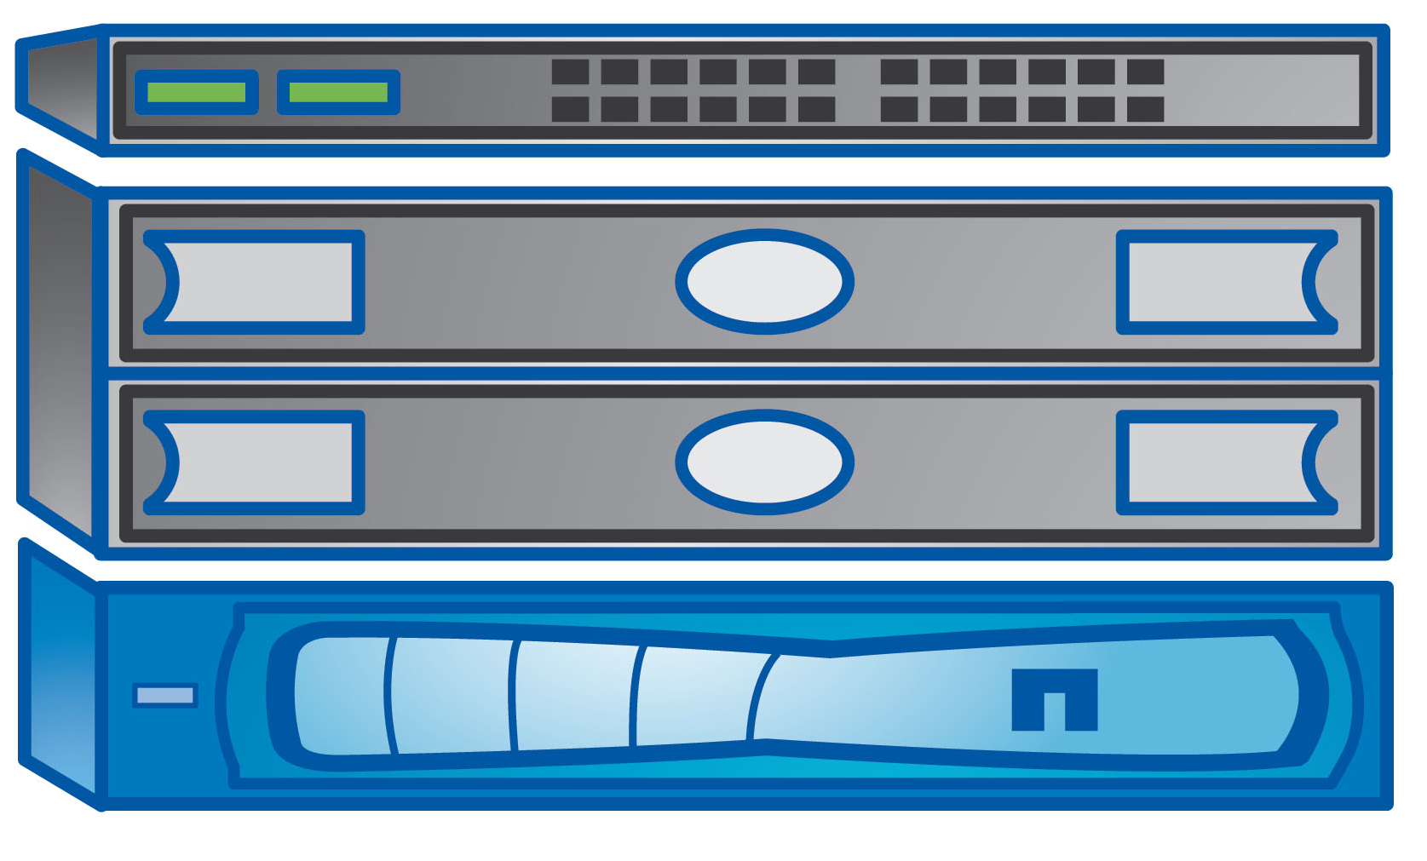
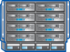


FlexPod Platforms
FlexPod Express
FlexPod Datacenter
FlexPod Select
Departmental Deployments
and VAR velocity
Target: primarily MSB, remote and departmental deployments
Massively scalable
All virtual
Target: Enterprise/service provider
Application Purposed
Target: Specific application deployments in the enterprise
App
App
App
File System
Distinct Architectures
Distinct Architectures
Direct or fabric
Entry level
UCS, FAS
UCS, Nexus, FAS
E-Series, FAS,

Slide 3
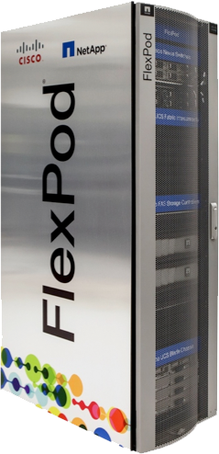
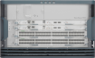

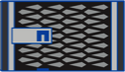
FlexPod Innovations
Infrastructure
Application
FlexPod®
with UCS Mini
Validation coming soon
SharePoint® with ACI
Exchange with ACI
SAP® HANA with ACI
Oracle® RAC with all flash
VDI (Citrix®, VMware®) all flash
Enterprise Apps
ACI-enabled
FlexPod
Including storage
Cloud and Management Solutions
Cisco® UCS® Director
OpenStack
Microsoft® Private Cloud Fast Track 4.0
All-flash
FlexPod

Slide 4

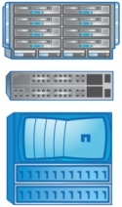

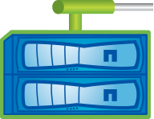
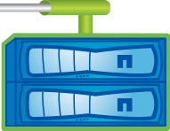
Expanded FlexPod Solution Family
10 000’s of users
FlexPod
10’s of users
NEW
FlexPod
with UCS Mini
FlexPod
FlexPod
Express
Consistent architecture from entry to large configurations
Scale up or down with no or minimal disruption
Common structure for support & management

Slide 5
Cisco Unified Computing System Mini
Overview

Slide 6
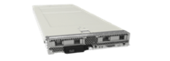
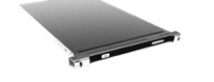
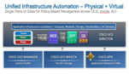
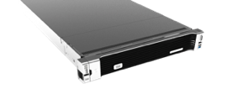
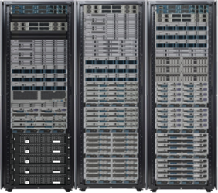

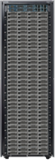
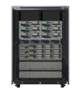
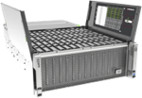
Next Wave of Unified Computing Powering Applications at Every Scale
Fourth Generation UCS Servers
UCS Management Innovation
UCS M-Series Modular Servers
UCS Mini
Core Data Center Workloads
UCS C3160
Edge-Scale Computing
Cloud-Scale Computing
UCS Management
Compute • Network • Storage • Virtualization • Management and Automation

Slide 7
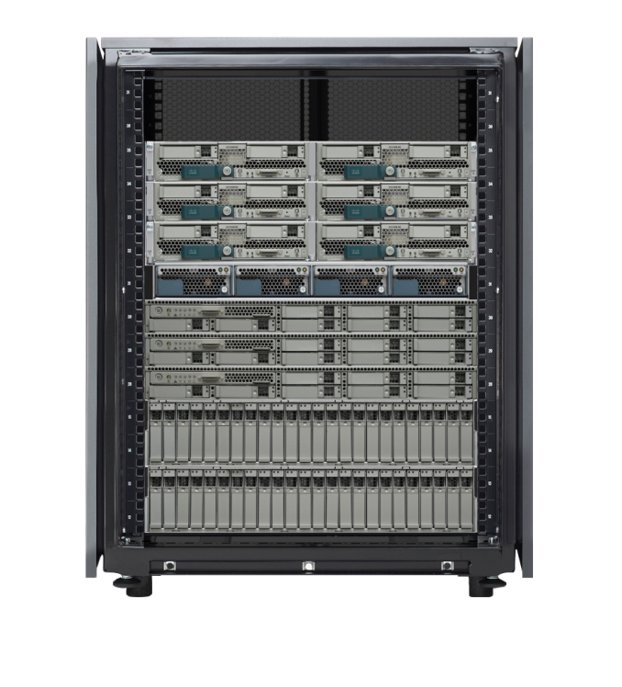
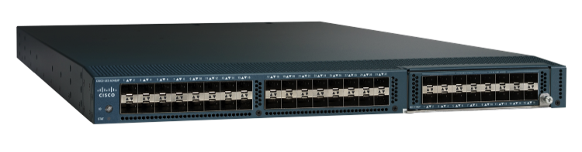
UCS Mini
6248 Fabric Interconnects
Notes:
See notes next slide

Slide 8
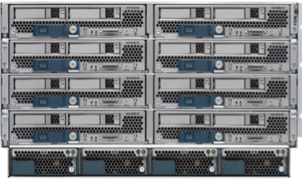
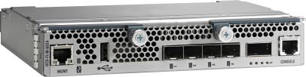
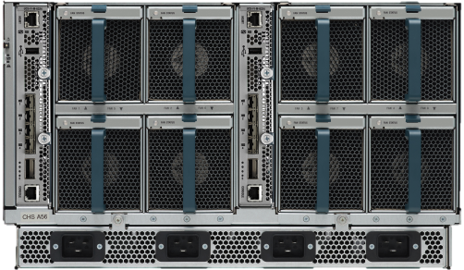
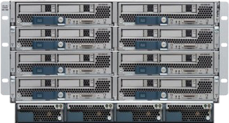
UCS Mini
New architectural entry point for Unified Computing at 1~15 server scale
6324 Fabric Interconnects
Full Power UCS in an all-in-one package:
Compute
Networking
UCS Manager
Standard UCS Blades / Fans / Power Supplies
UCS Mini
Enterprise Capability at Edge Scale
Connect up to 7 C-Series Rack Servers for Expanded Capacity
UP TO
29%
CapEx Savings
UP TO
36%
UP TO
34%
Lower Power
UP TO
80%
Fewer
Cables
TCO

Slide 9
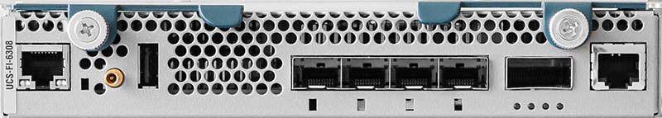
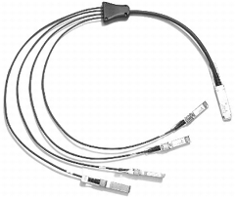
UCS 6324 Fabric Interconnect – Double Click
UCS 6324 Fabric Interconnect install in the IOM bay of the 5108 Chassis
Provide FI and IOM functionalities
16 x 10G-KR links to servers
1 x 10G crosslink
4 x 10G SFP+ Unified Ports for Uplink
1 x QSFP for scalability link
Ethernet Mgmt
USB
4x SFP+
1x QSFP+
Supported roles:
Server
Appliance
FCoE Storage
Console Port

Slide 10
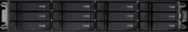
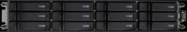
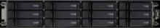
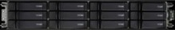
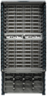
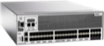
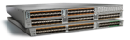
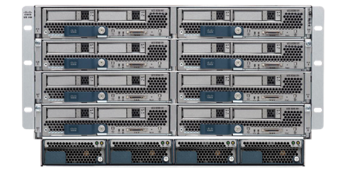
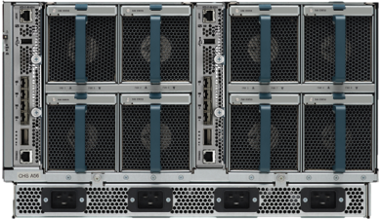
Storage Architectural Support
Network Attached Storage
Direct Attached Storage
SAN Attached
Storage
iSCSI/NAS/FC/FCoE
iSCSI/NAS/FC/FCoE
LAN
iSCSI/NAS
iSCSI/NAS
SAN
Cisco MDS Nexus 5000
ETH 1
ETH 2
ETH 1
ETH 2
FC/FCoE
Switch Mode
Network Attached File/Block
No certification required

Slide 11


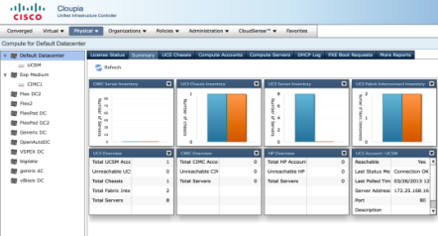
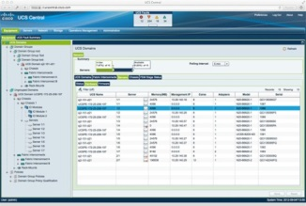
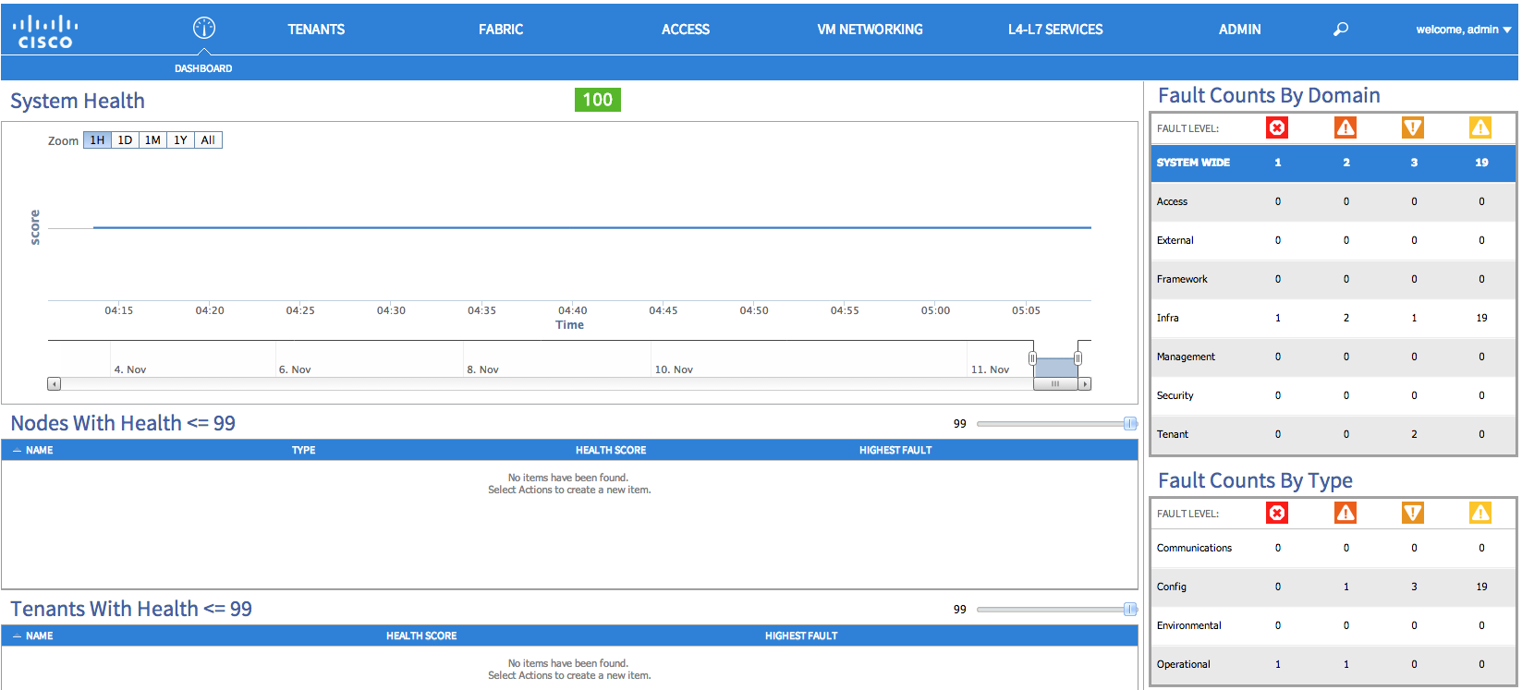
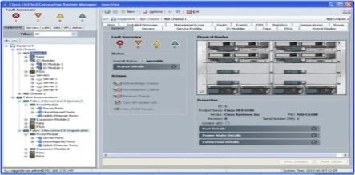
UCS Management Overview
44 ZETTABYTES
UCS DIRECTOR Centralized infrastructure control point for data center
UCS CENTRAL
APIC
UCS MANAGER
Manage heterogeneous Compute, Network & Storage across data centers.
Manages multiple UCS Domains
Manages ACI Fabric
Manages Single UCS domain

Slide 12
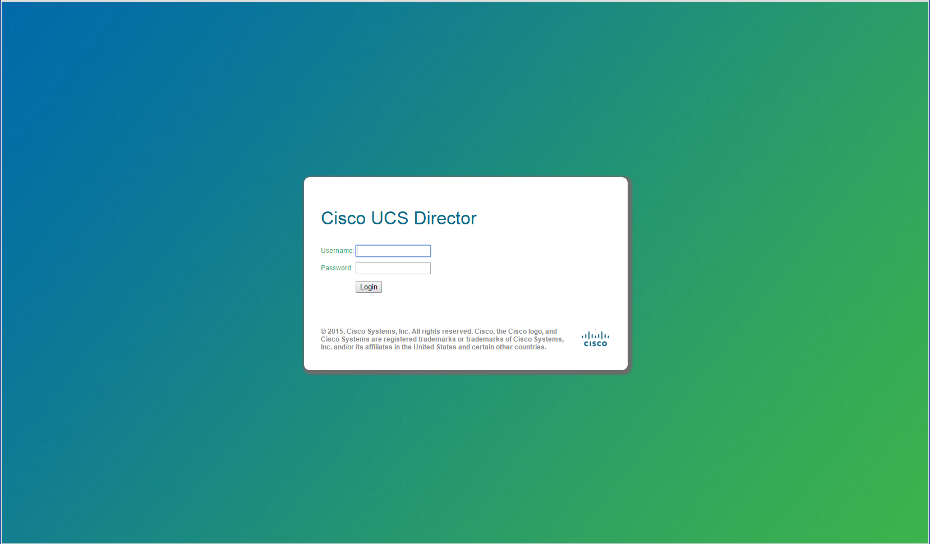
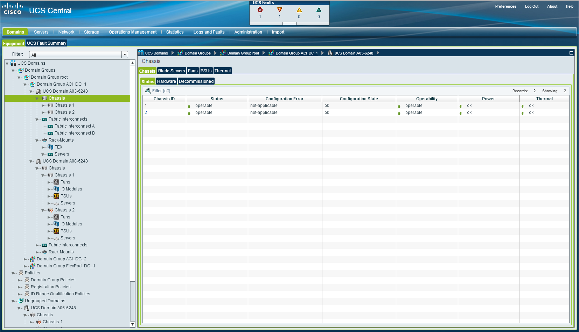
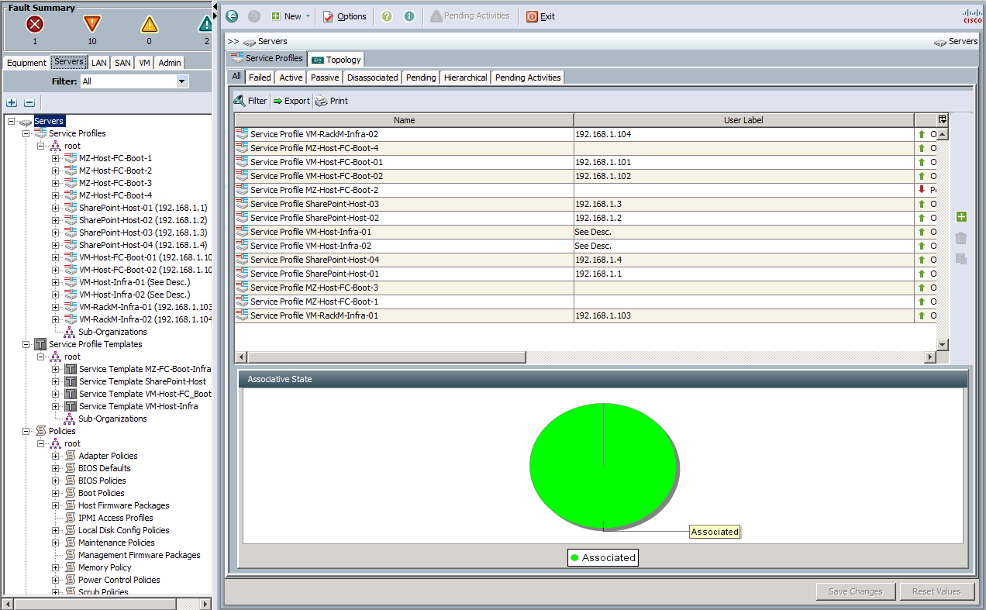
UCS Mini Centralized Management
UCS Director
UCS Central
UCS Manager
UCS Manager
UCS Manager
UCS Manager
UCS Manager
UCS Mini
Data Center
z
Branch Office /Remote Office
UCS Management
Compute • Network • Storage • Virtualization • Management and Automation

Slide 13
FlexPod Data Center with UCS Mini
Deployment Models

Slide 14
NetApp FAS2552 Double Click
NetApp FAS2500 Series Included software
Efficiency: FlexVol®, deduplication, compression, and thin provisioning
Availability: Multipath I/O
Data protection: RAID-DP, Snapshot
Performance: Storage QoS
Management: System Setup, OnCommand System Manager, OnCommand Unified Manager
Storage protocols: All supported data protocol licenses included

Slide 15
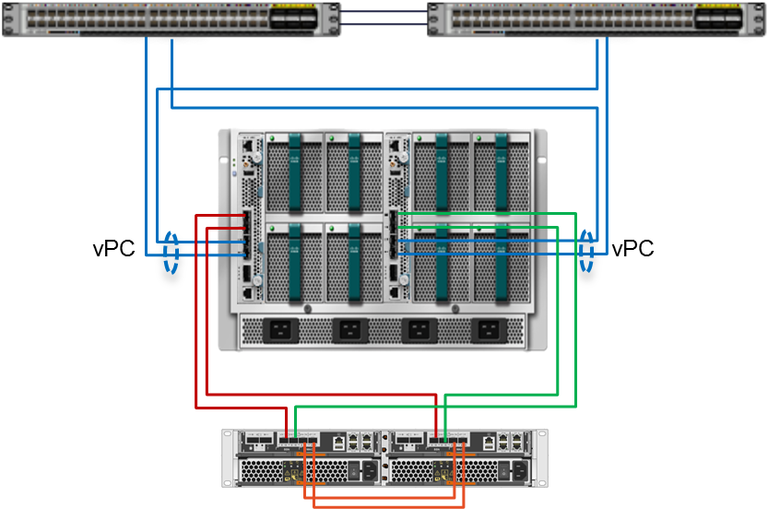
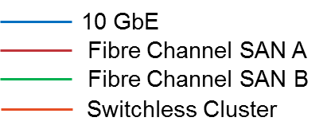
FlexPod Data Center with UCS Mini UCS Direct Attached FAS with Fiber Channel
CVD Posted
Components:
Nexus 9300, Cisco UCS Mini, NetApp FAS 2500 series
VMware vSphere 5.5u1 initial model
Highlights:
Dual homed UCS Fabric Interconnects using vPC (no storage traffic)
Switchless cDOT using direct-connect from FAS to UCS domain via Fiber Channel
Supports FC only storage access
Compute expansion ports available
1 x QSFP
Nexus 9300
UCS-Mini
FAS 2552

Slide 16
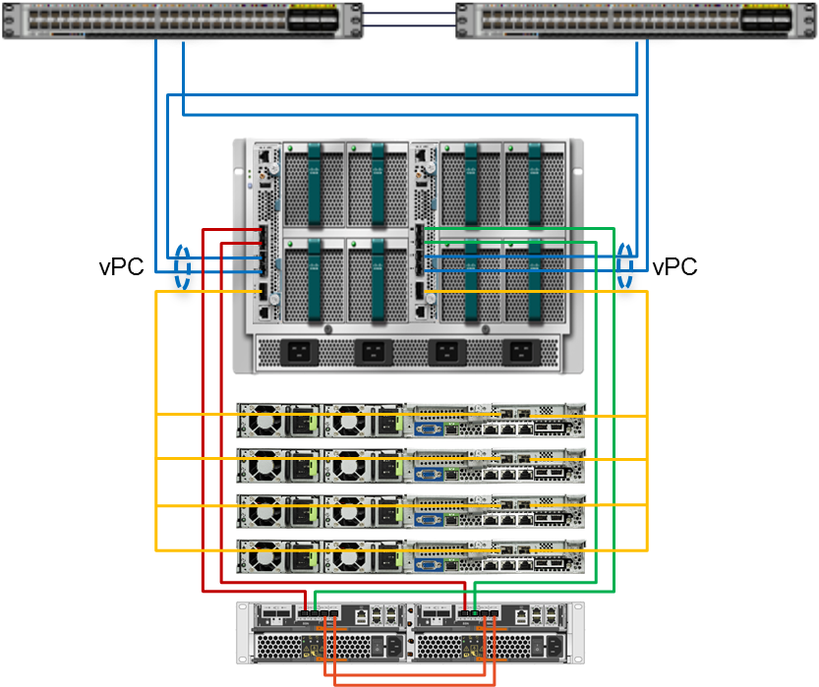
FlexPod Data Center with UCS Mini UCS Direct Attached FAS with Fiber Channel – Scale Points
Scale points
UCS Mini will support a maximum of twelve servers in this model
Four additional C-series compute platforms
FAS2552 supports:
24 Internal drives
Max 144 drives (internal/external)
Max 749TB
Nexus 9300
UCS-Mini
UCS C-Series
FAS 2552

Slide 17
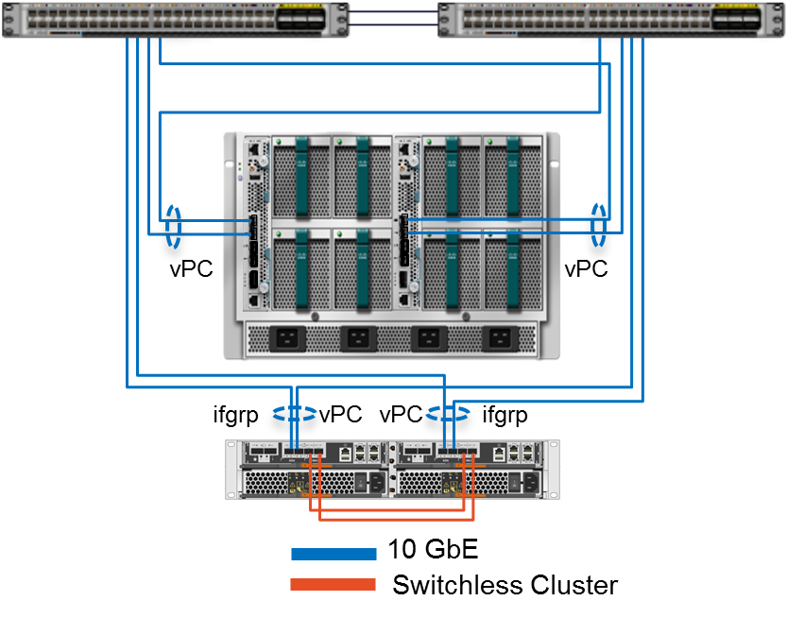
FlexPod Data Center with UCS Mini Ethernet Only Solution
Components:
Nexus 9300, Cisco UCS Mini, NetApp FAS 2500 series
VMware vSphere 5.5u1 initial model
Highlights:
Dual homed UCS Fabric Interconnects using vPC
Dual homed FAS using vPC
Switchless cDOT
Supports NFS, SMB and iSCSI storage access
Compute expansion ports available
2 x SFP
1 x QSFP
Nexus 9300
UCS-Mini
FAS 2552

Slide 18
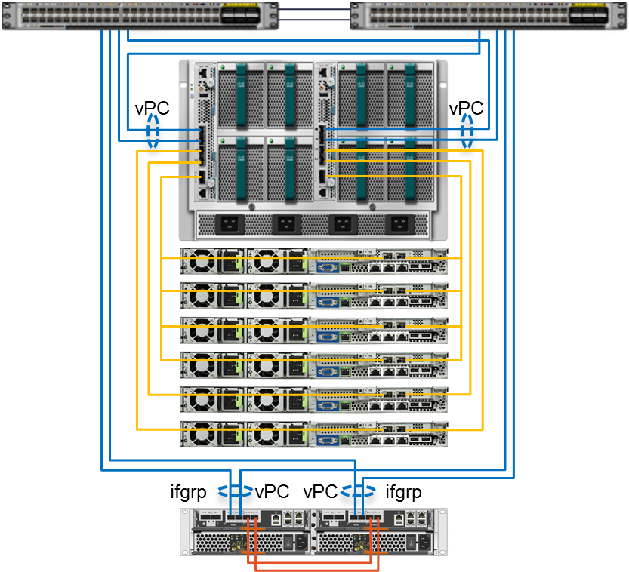
FlexPod Data Center with UCS Mini UCS Ethernet Only – Scale Points
Scale points
UCS Mini will support a maximum of fourteen servers in this model
Six additional C-series compute platforms
FAS2500 supports:
24 Internal drives
Max 144 drives (internal/external)
Max 749TB
Nexus 9300
UCS-Mini
UCS C-Series
FAS 2552

Slide 19
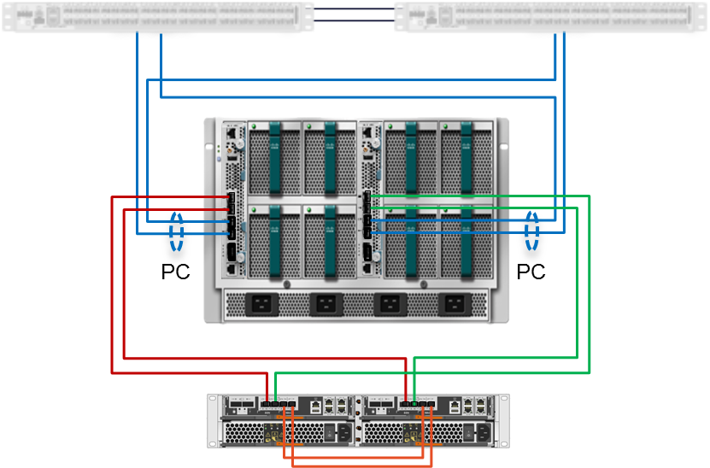
FlexPod Express with UCS Mini UCS Direct Attached FAS with Fiber Channel
Standard switch approach
FC used to remove generic switch from compute-to-storage communication
Switches provide Ethernet transport between UCS Fabric Interconnects (e.g. vMotion)
Nexus always recommended for comprehensive support and performance
FlexPod Express validated with the Nexus 3524 platform which supports vPC
UCS Central and UCS Director allow for remote (or local) management
Standard Switch
UCS-Mini
FAS 2552

Slide 20
FlexPod Support Model

Slide 21
FlexPod Support Model
Customer
Chartered to resolve interoperability issues
Global 24x7 capability
Cisco
Customer Support
First Line
NetApp
Customer Support
First Line
Cooperative Support Model
Process alignment for cooperative support
If Development or Engineering Required
Coordinated real-time engagements for customers on supported products
Cisco
Eng.
NetApp
Eng.

Slide 22
Cisco Solution Support Services (SSPT) New Engagement Model
Now – Solution Support Engagement Model
UCS Issue
Original Engagement Model
Customer or Channel Partner
Cisco Product Support
Product-level
Support
Cisco
All issues may go to SSPT
Coordinate
SSPT
Contract
Cisco Solution Support
Solution
Technology
Partners
Coordinate
Product-level
Support
Storage Issue
Partner Product Support
1
2
3
Coordinate with both sources to solve problems in both areas
Access a team of Cisco DC Infrastructure experts who are ready to lead in resolution of any issues found within the supported infrastructure
The Solution Support team will work with you to resolve your issue, regardless of where that issue leads or who needs to be involved in resolution

